Slide 1
CSc 553 Principles of Compilation 06. Register Allocation
Saumya Debray
The University of Arizona
Tucson, AZ 85721

Slide 2
Register allocation
Goals:
place frequently accessed values in registers.
reduce (minimize?) memory accesses.
Interaction with code generation:
Code generation assumes an infinite no. of “virtual registers”.
Register allocation: determine which virtual registers get mapped to physical registers.
Register assignment: determine the actual mapping from physical registers to virtual registers.

Slide 3
Register allocation
Local (basic block level)
simpler to implement
limited performance benefits
Scope of register allocation:
Global (function level)
implementation is more complex
better performance benefits

Slide 4
Local register allocation

Slide 5
Bottom-up local register allocation
Consider the instructions in the basic block in order. When a register is needed for an operand:
if a free register is available, use it
otherwise, free up a [least-cost] register whose next use is furthest in the future:
generate code to store its contents into memory
update bookkeeping info accordingly
At the end of the block, store (live) variables back into memory
Bookkeeping info: register contents; location of variables

Slide 6
Issues with local register allocation
•
: register loads/stores
Register loads and stores at every basic block boundary
80-20 rule suggests that this will typically result in a lot of memory traffic
performance gains from register usage are diluted
•
•
•
•
•
•
•
•

Slide 7
Global register allocation

Slide 8
Global register allocation
Main issues:
definitions and uses of a variable should refer to the same register
live ranges
different variables should not get mapped to the same register
graph coloring
x = …
x = …
… = x
… = x

Slide 9
Live ranges

Slide 10
Live ranges
A live range consists of a set of definitions D and uses U of a variable x, such that:
for each use u ∈ U, every definition that can reach u is in D
for each definition d ∈ D, every use that d can reach is in U
Live ranges form the unit of global register allocation
each live range for a variable is mapped to a particular storage location (a specific register; or else memory)

Slide 11
Live ranges
int f(...) {
for (x = ...; x < n; x++) {
... use(x) ...
... use(x) ...
}
... use(y) ...
... use(y) ...
x = ...
... use(x) ...
... use(x) ...

Slide 12
Live ranges: Example
 | Live Ranges
 | x |  | y
x = y + 1
z = x + a
y = u + w
v = x + 4
x = y * z
v = x - y
u = v / x

Slide 13
Identifying Live Ranges
Carry out reaching definitions analysis.
For each definition d_{x} of a variable x, let U(d_{x}) be the set of uses associated with d_{x:}
U(d_{x}) = { i | instruction i uses x and d_{x} reaches i }.
LR(d_{x}) = {d_{x}} ∪ U(d_{x}). /* Live range = the definition + all its uses */
repeat
if there are two definitions d₁ and d₂ of a variable x such that LR(d₁) and LR(d₂) overlap, merge LR(d₁) and LR(d₂).
i.e., set LR(d₁) and LR(d₂) to LR(d₁) ∪ LR(d₂).
until no further merging occurs.

Slide 14
Register interference graph

Slide 15
Register allocation via graph coloring
Graph coloring is a systematic way of allocating registers and managing spills.
Consists of two passes:
Target machine instructions are selected as though there is an unbounded no. of symbolic registers.
Physical registers are assigned to symbolic registers in a way that minimizes spill costs.
This is done by constructing a register interference graph for the function being compiled, and then k-coloring this graph (k = no. of available registers).

Slide 16
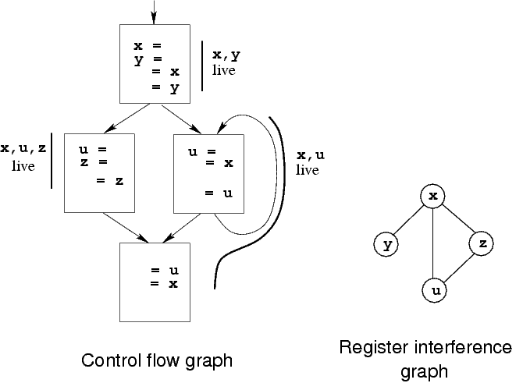
Register interference graphs
Nodes ≈ live ranges
There is an edge between two nodes if they can be simultaneously live [“interference”]
Example:

Slide 17
Graph coloring: Overview
The Graph Coloring problem:
Given a graph G = (V, E) and a fixed finite set of colors C, find a mapping color: V → C satisfying:
for every (a, b) ∈ E: color(a) ≠ color(b)
For register allocation:
the set of colors corresponds to the set of registers
If there are k registers, the no. of colors = k.
NP-complete in general
no known algorithm that will always compute the optimal solution efficiently
resort to heuristics that work well in practice

Slide 18
Graph coloring: Example
Colors =
4
4
2
2
3
5
3
5
1
1
6
6


Coloring 1
Coloring 2

Slide 19
Graph coloring: Heuristic
A coloring heuristic often used for register allocation:
repeat
delete each node with fewer than k neighbors
/* we can always find a color for these nodes later */
until either:
the resulting graph is empty:
work backwards to produce a k-coloring of the original graph; or
every node has ≥ k neighbors:
pick a node x to spill, delete x from the graph, and repeat the above process.

Slide 20
Graph coloring register allocation: Issues
Identifying live ranges
Constructing the interference graph
Choosing spill nodes.
need to estimate spill costs.

Slide 21
Constructing the Interference Graph
Carry out liveness analysis for the function
Create a graph node for each live range
for each basic block B, traverse B backwards:
let LR_{x} denote the live range for a given occurrence of a variable x
initialize LiveNow = {LR_{w} | w ∈ LiveOut(B)}
for each instruction x = y ⊕ z :
for each live range LR_{i} ∈ LiveNow :
add the edge (LR_{x}, LR_{i})
update:
LiveNow = (LiveNow – {LR_{x}}) ∪ {LR_{y}, LR_{z}}

Slide 22
Choosing a node to spill
Estimating spill cost:
Let Refs(x) = the set of points where a variable x is referenced (i.e., defined or used); and
freq(p) = the execution frequency of a point p
Then the cost of spilling x is (roughly):
cost(x) = Σ{ freq(p) | p ∈ Refs(x) }
Spilling:
choose a node to minimize cost/degree. [Chaitin 82]
This picks nodes that are relatively inexpensive to spill, but which lowers the degrees of many other nodes.

Slide 23
Estimating Execution Frequencies
Simple approach: heuristics relating to loop nesting depth:
preorder traversal of the syntax tree;
execution frequency of root node = 1;
each loop assumed to execute a “reasonable” no. of times (typically, 8–12);
each branch of a conditional assumed to be equally likely.
This effectively pushes spill code away from inner loops.

Slide 24
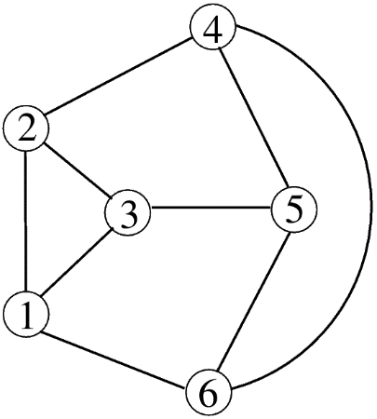
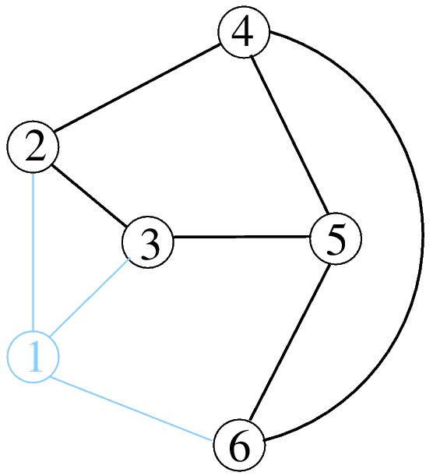
Spilling: Example
Interference graph (suppose the no. of colors = 3):
Node | Cost | Cost/Degree
1 | 2 | 0.67
2 | 11 | 3.67
3 | 21 | 7.00
4 | 5 | 1.67
5 | 5 | 1.67
6 | 3 | 1.00
After spilling node 1, the graph becomes 3-colorable:

Slide 25
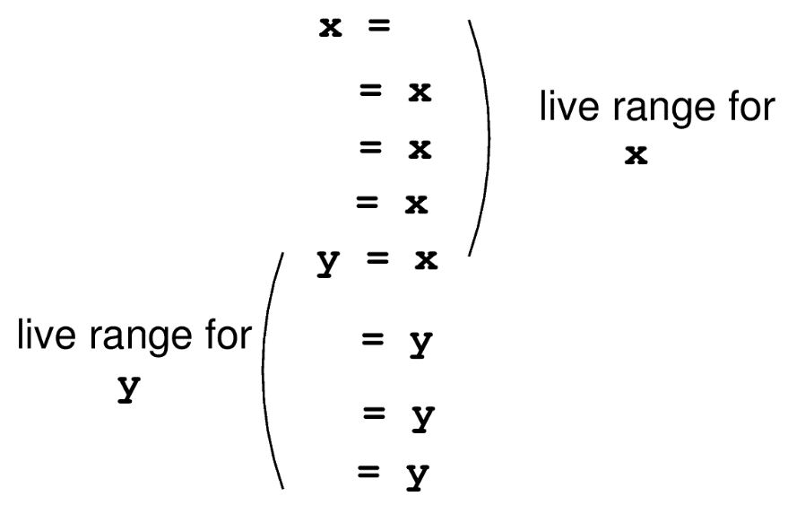
Coalescing Live Ranges
Sometimes we can use one register for two different live ranges.
Benefits:
Coalescing live ranges LR1, LR2 reduces the degree of any live range that interferes with both LR1 and LR2.
Eliminates the copy operation.
Reduces the no. of live ranges the compiler has to deal with.

Slide 26
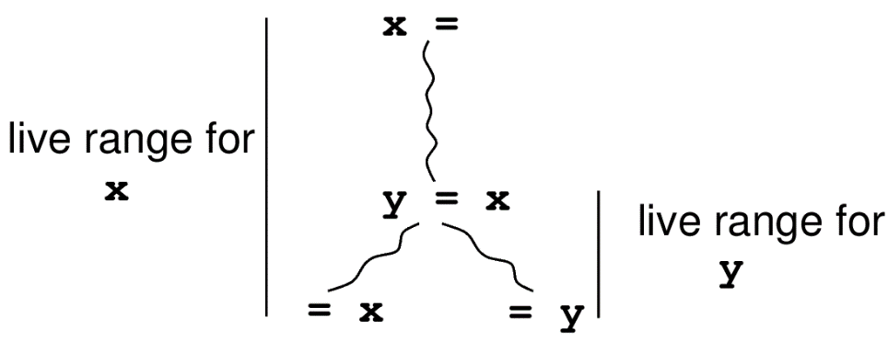
Coalescing Live Ranges (cont’d)
In general, coalesce two live ranges A and B if:
A and B are connected only at a copy statement; and
don’t interfere with each other elsewhere.
Ordering of coalescing:
Coalescing two live ranges can prevent subsequent coalescing of other live ranges (i.e., ordering matters).
Consider coalescing for copy instructions with highest execution count first.

Slide 27
Register allocation: Summary
multiple options possible,
with different tradeoffs
multiple options possible,
with different tradeoffs
control
flow
graph
register
interference
graph
register
allocation
decisions
live
ranges
reaching
definitions
liveness
analysis
graph
coloring
spill cost
estimation

Slide 28
Register allocation: Overall Algorithm
Find live ranges, construct the interference graph.
repeat until no change:
coalesce live ranges to eliminate copy instructions
recompute interferences.
Estimate spill costs.
Simplify the interference graph
e.g., use heuristic discussed earlier
Use the stack to visit unspilled nodes in reverse order, and assign colors to them
Generate code to use assigned registers.

Slide 29
Code generation
Without register allocation:
codegen("x = y + z"):
reg1 = gen_load(y)
reg2 = gen_load(z)
reg3 = find_reg()
emit("reg3 := reg1 + reg2")
gen_store(reg3, x)

Slide 30
Code generation
Without register allocation:
codegen("x = y + z"):
reg1 = gen_load(y, regs_to_use, regs_to_avoid)
reg2 = gen_load(z, regs_to_use, regs_to_avoid)
reg3 = find_reg(regs_to_use, regs_to_avoid)
emit("reg3 := reg1 + reg2")
gen_store(reg3, x)

Slide 31
Effects of Global Register Allocation
[Chow & Hennessey: MIPS C compiler]
Program | % Reduction
 | cycles | total loads/stores | scalar loads/stores
bm (theorem prover) | 37.6 | 76.9 | 96.2
diff (file comparison utility) | 40.6 | 69.4 | 92.5
yacc (parser generator) | 31.2 | 67.9 | 84.4
nroff (document formatter) | 16.3 | 49.0 | 54.7
C compiler front end | 25.0 | 53.1 | 67.2
MIPS assembler | 30.5 | 54.6 | 70.8

